Slide 1
Exploring relationships
between attitudes towards IT and gender
of university students in Ukraine and Latvia
Olena Mykhailenko
OTU, Canada

Slide 2
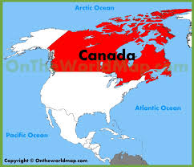
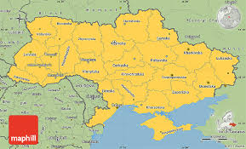
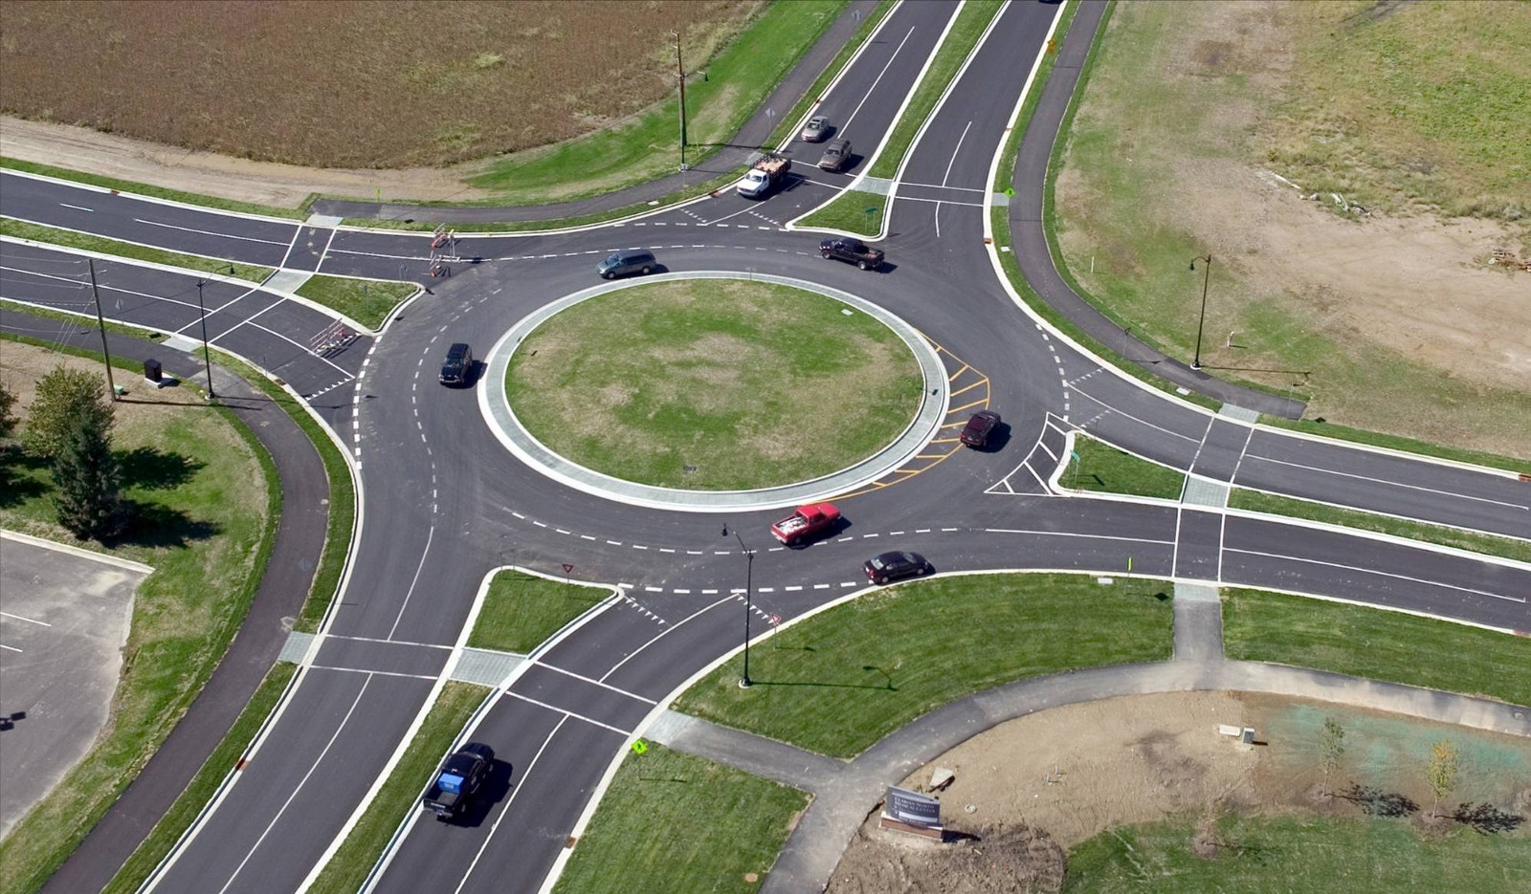
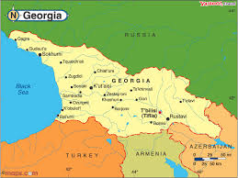
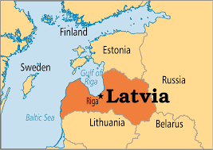
Economics
Business studies
Post-industrial learning
Cross-cultural studies

Slide 3
READINESS - characteristics of people and their contexts in relation to a target activity
(F ⬄ T).
Previous studies (2015-2018):
Digital-skill readiness of university students in Ukraine and Georgia for new forms of collaborative online learning
Present study (started in 2018):
shifted attention to dispositional readiness: exploring technology-related attitudes and personal cultural orientations of male and female university students in Ukraine and Latvia

Slide 4
Girls largely tend to avoid the ICT-related studies and digital careers
57% of tertiary graduates in Europe are women, but only 24,9% of them graduate in ICT-related fields.
Among 8 million ICT specialists in the EU, only less than 17 % are females.

Slide 5
Digitalization:
Growing females’ economic and social vulnerability?
Growing gap between countries?
Growing inequality?

Slide 6
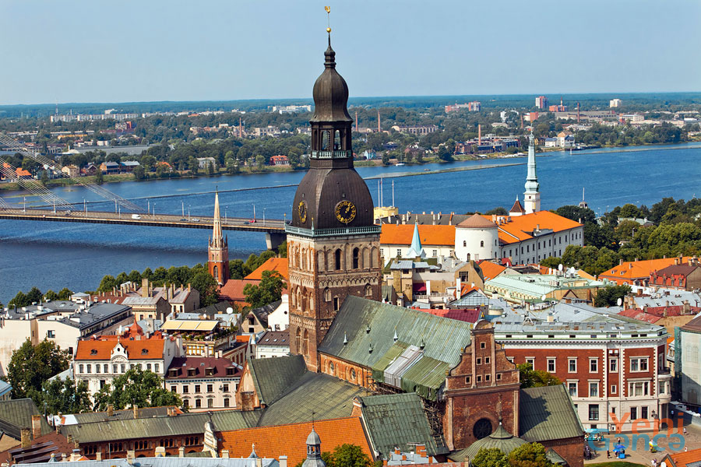
ICT sectors of Latvia and Ukraine are rapidly growing:
about 20% yearly
(EECA in average - 6,7%)
Females among IT specialists:
Latvia - 24,8%
Ukraine-20%
Bulgaria, Romania – more than 27%
but Hungary, Slovakia, Czech Republic - 10-12%
EU average 16,7%

Slide 7
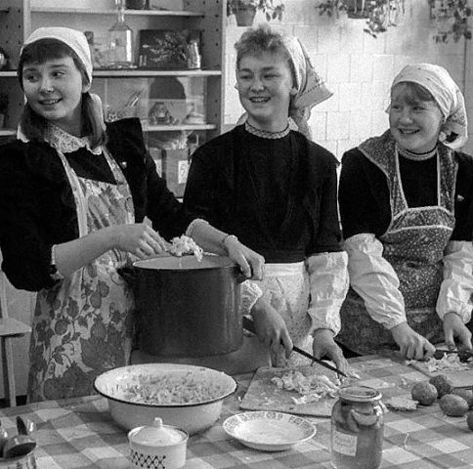
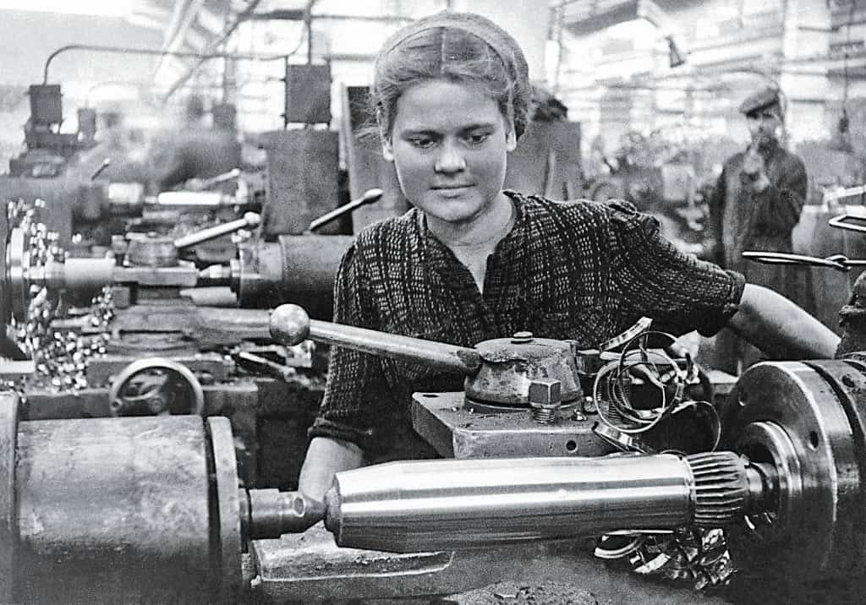
“The root causes can be found in patriarchal attitudes and stereotypes” (Gender Equality Report, UN, 2018).
“The post-Soviet world has a specific view on the gender problem: the majority of the population doesn’t take gender problem seriously” (Savelyev, 2002).
Unequal gender attitudes get discursively reproduced and institutionalized in educational institutions (Fraser-Thomas & Beaudoin, 2004; Gorski, 2009).

Slide 8
Research questions
What are the general levels of IT-directed optimism, anxiety, interest and sense-of-opportunity among (a) Latvians and Ukrainians and (b) males and females?
2. Are there significant differences at the factor level between the measured attitudes of nations and genders?

Slide 9
Data-Collection apparatus
Attitudes towards information technology, inclusive of values, beliefs, interests, anxieties and gender perceptions for explore IT worker shortages and gender divides (Gokhale, Brauchle, & Machina, 2013).
# | Factors | Description
1 | Positive Effects (PE) (optimism) | Beliefs in potential positive effects of IT at work
2 | Negative Impact (NI) (anxiety) | Anxiety related to the potential negative consequences of IT on human wellness and survival
3 | Learning Interest (LN) (interest) | General interest and motivation for acquiring IT knowledge
4 | Gender Equality (GE) (sense of opportunity) | Perceptions of equal opportunity in IT careers
Online survey of 23 statements, grouped into subscales,
with 5-point Likert scale of agreement. Translated into Latvian and Ukrainian.

Slide 10
Data-Collection settings

Slide 11
Are there significant differences in attitudes toward IT
between all Ukrainian and Latvian participants?
 | PE | NI* | GE* | LN*
Latvia (257) | 3.81 | 3.24 | 4.31 | 3.60
Ukraine (749) | 3.84 | 2.99 | 4.06 | 3.86
T-test *p<.01
NI (p=.000), GE (p=.000), LN (p=.000)

Slide 12
Are there significant differences in attitudes toward IT
between all males and all females?
 | PE | NI* | GE | LN*
Males (257) | 3.84 | 2.95 | 4.15 | 3.97
Females (749) | 3.85 | 3.11 | 4.11 | 3.70
T-test *p<.01
NI (p=.007), LN (p=.000)

Slide 13
UKRAINE
Are there significant differences in attitudes toward IT
between Ukrainian males and Ukrainian females?
 | PE | NI | GE | LN*
Males (282) | 3.84 | 2.95 | 4.15 | 3.98
Females (467) | 3.85 | 2.94 | 4.13 | 3.78
T-test *p<.01
LN (p=.000)

Slide 14
LATVIA
Are there significant differences in attitudes toward IT
between Latvian males and Latvian females?
 | PE | NI | GE | LN*
Males (44) | 3.77 | 3.00 | 4.27 | 3.91
Females (213) | 3.83 | 3.29 | 4.32 | 3.54
T-test *p<.01
LN (p=.009)

Slide 15
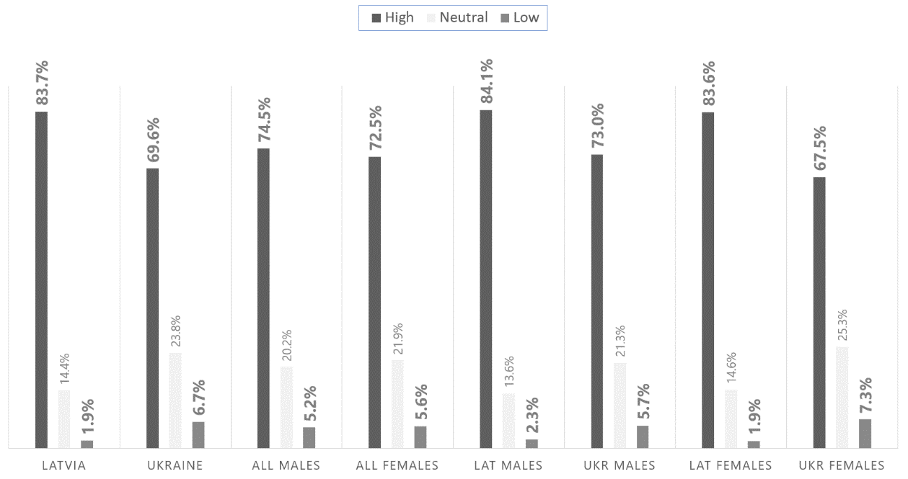
Measured levels of perceived gender equality (GE)
in information-technology workplaces

Slide 16
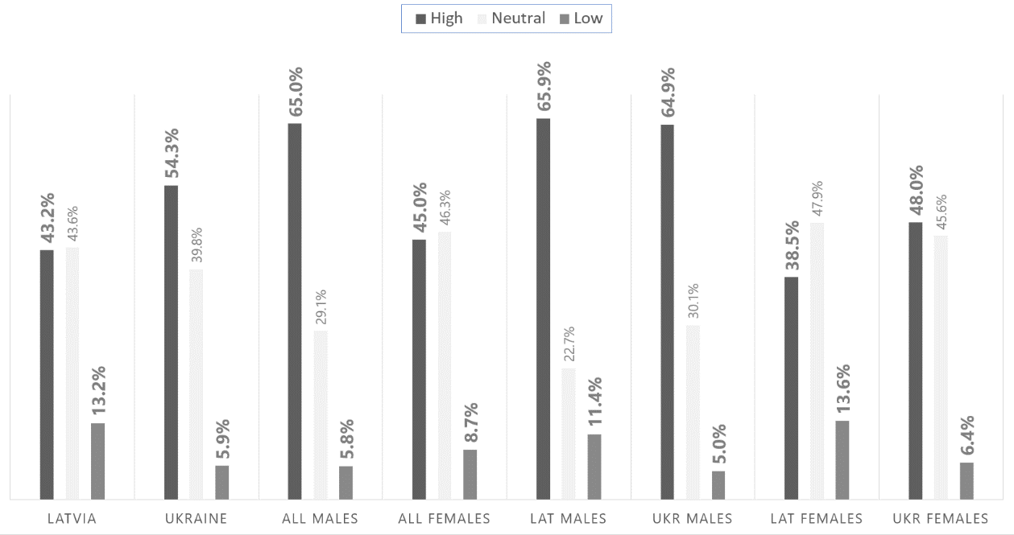
Measured levels of interest in learning about information technology (LN)

Slide 17
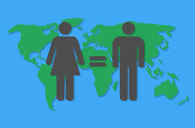
Conclusions
National Level
The differences between genders are more pronounced in Ukraine than in Latvia
Latvian group has stronger commitment to the principles of gender equality than the Ukrainian one
Ukrainian group is set generally more positive toward IT, when the Latvian participants expressed more moderate attitudes

Slide 18
Conclusions
Gender Level
Men in both samples are more loyal to gender equality than women
Women in both national samples expressed significantly higher concern than men about the technologies’ potential ability to eventually destroy the earth
Women are the most “rigid” carriers of the traditional division on “masculine” and “feminine” fields of professional activities

Slide 19
Conclusions
General notes
Significant gender differences are mostly concentrated in the assessment of the Interest in Learning about IT
Gender-oriented career decisions might be conditioned with a complex set of psychological and socio-cultural factors, which need deeper research and addressing in educational programs

Slide 20
Discussion:
Should education react?
If yes, how?

